Slide 1
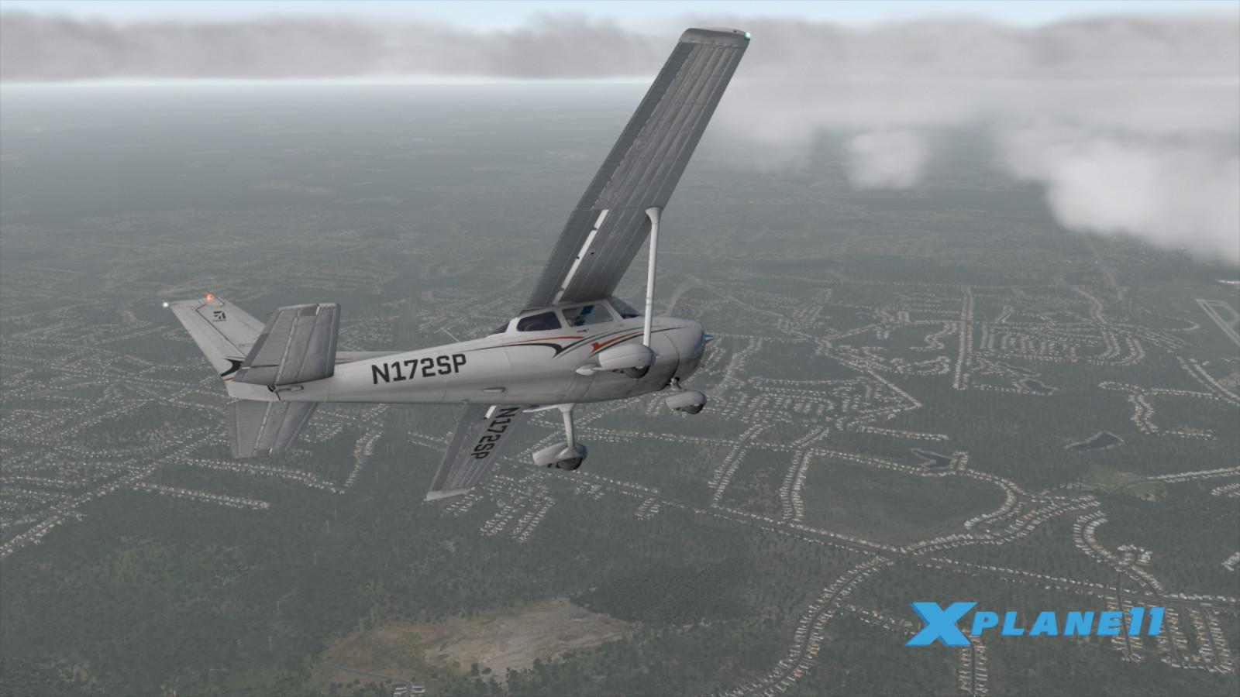
INTELLIGENT AUTOPILOT SYSTEM FOR AIRCRAFT MANEUVERS IN X-PLANE 11
Rizwan, Oneeb, Krishna, Priya, Martin

Slide 2
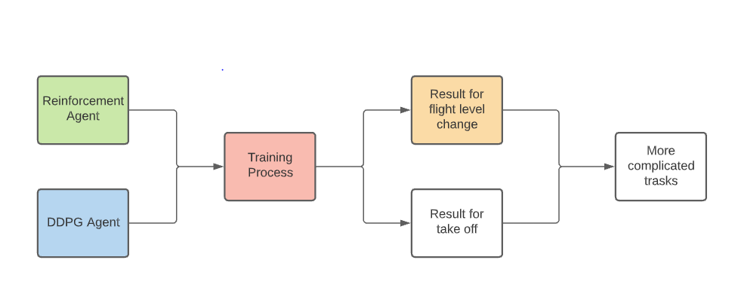
Project Timeline
Green: Done, Blue: In process, Red: Error/Issue, Yellow: Partial done

Slide 3
Progress for Week #7
Finish our XPane-Gym Environment and fine tune our rewards function
Show Preview of an RL based agent capable of changing altitude levels
Work on DDPG agent in parallel
Develop more intuitive understanding of RL algorithms being used and read through more relevant literatures

Slide 4
Updates and Issues
Continuous action and observation spaces mean that our agent has to learn A LOT of information.
Currently have sleep(1) for letting the environment change state. Episode time is > 60s for just 60 steps.
Which means an extremely long training time (at least with a Vanilla REINFORCE approach).
Ran the agent for 200 episodes to gauge the performance of agent to climb from 3600m to 4000m.
REINFORCE agent continues to perform poorly at least for the number of training episodes we ran.

Slide 5
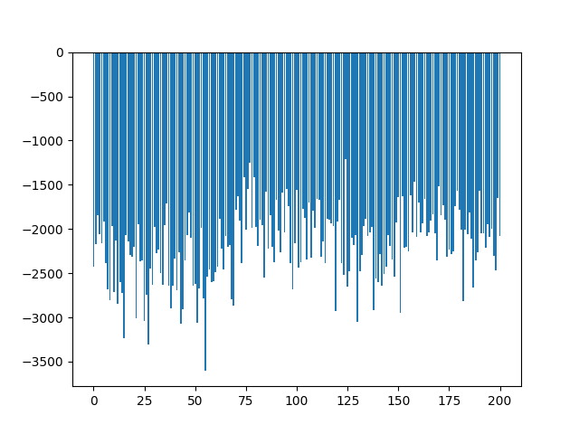
Updates and Issues
Difference between the altitude at target state and at time when the episode finishes.

Slide 6
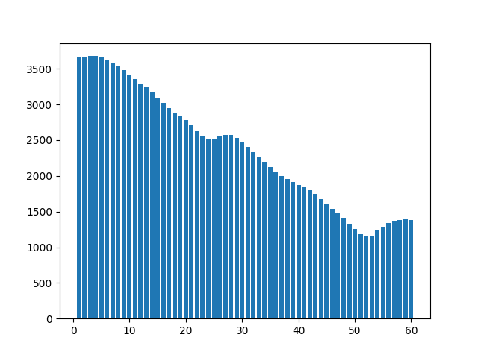
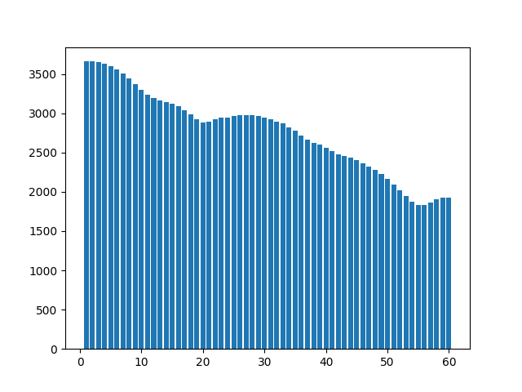
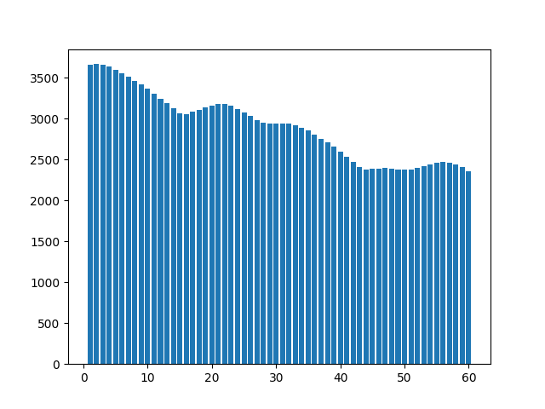
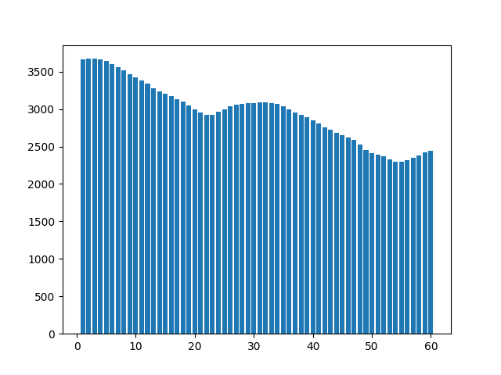
Updates and Issues
Target Altitude: 4000m
50th Episode
100th Episode
Pattern observed in the flight trajectory during training episodes.
However, the sample space was still too small to say anything conclusively.
150th Episode
200th Episode

Slide 7
Observations Proposed Solutions
Observations:
Initially the target state was 4000m, and during training the agent never climbed to that level so it never received a strong positive reward signal.
Because of very small positive reward signal, learning might have been slow
Current Solutions:
Changed the target state to 2500m (and mission profile to descent). So, that even without doing anything and falling freely, the agent gets to pass through the target state.
Let it run for several thousand episodes before giving out a verdict.
Remove sleep time - allowing for more steps per episode
Note: even w/ DDPG implementation of a bipedal walker in OpenAI Gym, there is only some slight progress by 600 episodes

Slide 8

Proposed Solution

Slide 9
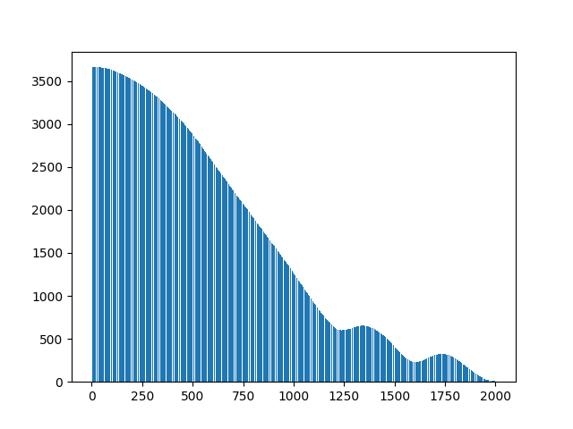
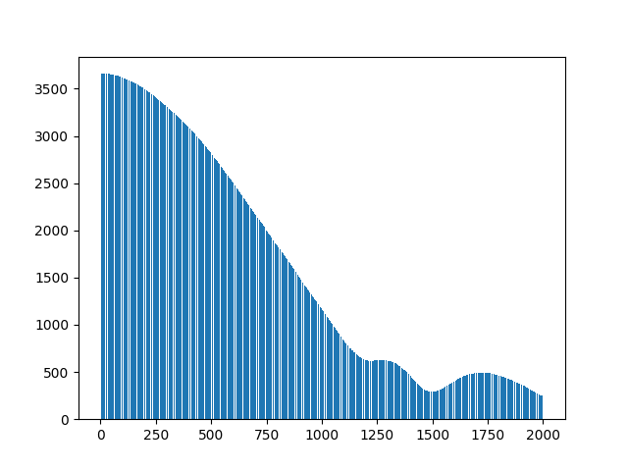
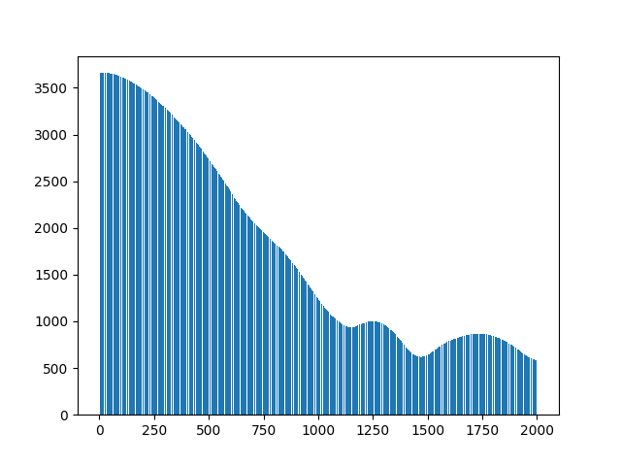
Proposed Solution
With the target state revised, a different behaviour started to emerge during the early phase, which again is inconclusive unless we run a few thousand episodes.
Observations:
Steep dive in the start.
Attempt to pitch up once the aircraft moves past the target state.
The agent is still running...
Target Altitude: 2500m

Slide 10
Goal for Week #8
Finish implementation of DDPG agent
Increase scope of learning for the agent
Flight level change + Heading change
Develop playback function to replay the result in X-plane 11
Improve visualization of achieving goal states

Slide 11
Individual Contribution
Rizwan: Training the agent
Rengapriya: understand & implement DDPG
Martin: develop baseline of DDPG algorithm, proceed to tuning part
Krishnateja: understand and implementing REINFORCE
Oneeb: understand and implementing REINFORCE

Slide 12

THANK YOU

Slide 13
Progress for Week #8
Ran multiple cases for REINFORCE algorithm with varying rewards and hyperparameters.
Finalised implementation of DDPG algorithm
Started work on PPO algorithm in parallel for performance comparison.

Slide 14
Case 1
NN Architecture:
Input_layer : 8 → ReLU
H1_layer : 256 → ReLU
H2_layer: 256 → ReLU
Output Layer: 4 (mu) → tanh
: 4 (sigma) → Sigmoid (clipped to keep it positive)
𝜶 = 0.0001, 𝜸: 0.9
Randomly initialised weights
Reward: +2000 for every step in successful range
: -1 for each timestep
: -10000 for crashing
: -5000 for finishing outside the successful range
Results (800): Unsatisfactory and inconclusive, aircraft kept crashing.

Slide 15
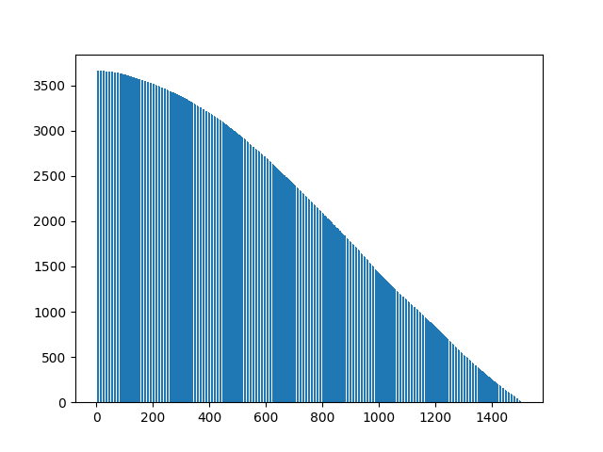
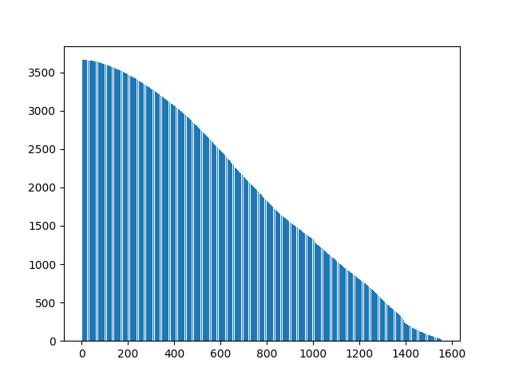
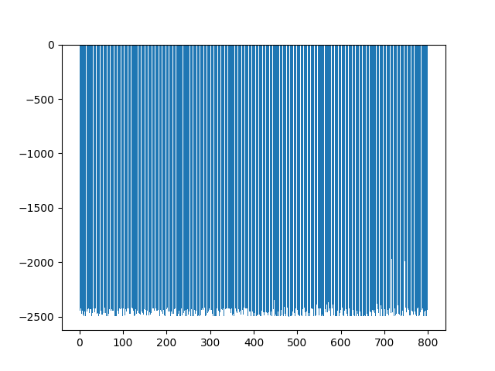
Case 1 Observations
Episode 1
Episode 800
Altitude Difference

Slide 16
Case 2
NN Architecture:
Input_layer : 8 → ReLU
H1_layer : 256 → ReLU
H2_layer: 256 → ReLU
Output Layer: 4 (mu) → tanh
: 4 (sigma) → ELU + 0.001 (to make it positive)
𝜶 = 0.0001, 𝜸: 0.9
Reward: +2000 for every step in successful range
: -1 for each timestep
: -100000 for crashing
: -5000 for finishing outside the successful range
Results (280 Episodes): Unsatisfactory! After crashing in the first couple of episodes, the aircraft stopped descending.

Slide 17
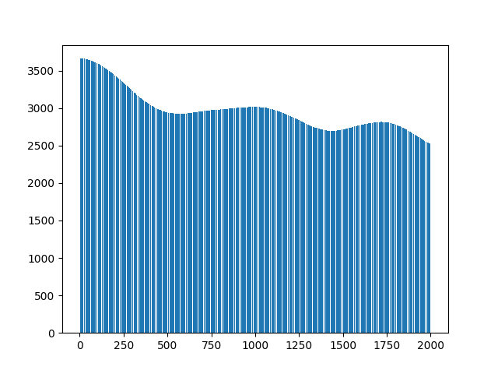
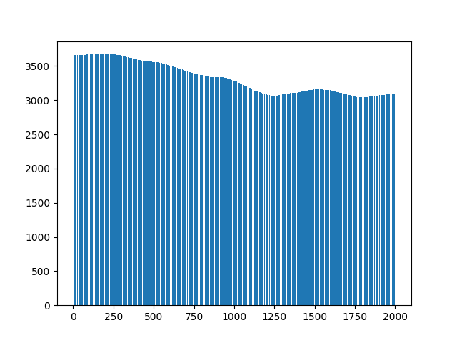
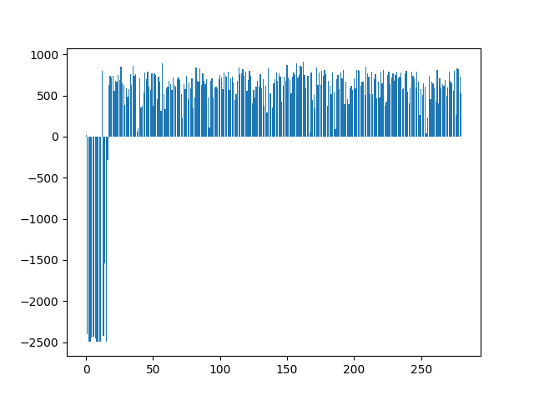
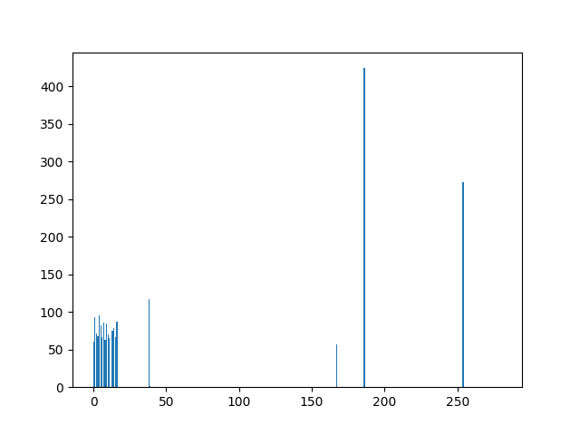
Case 2 Observations
Episode 1
Episode 250
Successful Steps
Altitude Difference

Slide 18
Case 3
NN Architecture:
Input_layer : 8 → ReLU
H1_layer : 256 → ReLU
H2_layer: 256 → ReLU
Output Layer: 4 (mu) → tanh
: 4 (sigma) → ELU + 0.001 (to make it positive)
𝜶 = 0.0001, 𝜸: 0.9
Reward: +6000 for every step in successful range
: -1 for each timestep
: -100000 for crashing
: -5000 for finishing outside the successful range
Results (1000 Episodes): Unsatisfactory! After crashing in the first couple of episodes, the aircraft stopped descending.

Slide 19
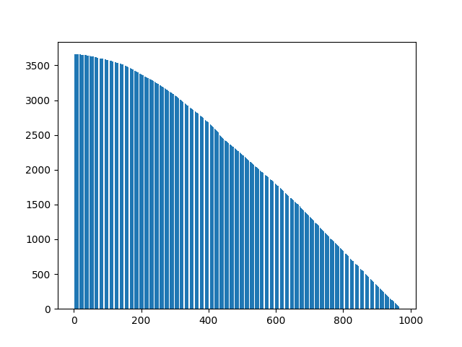
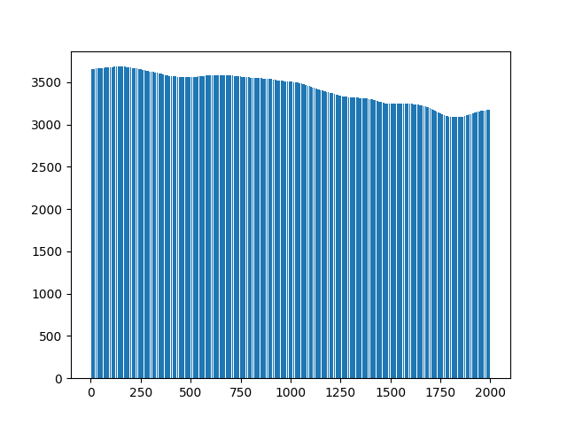
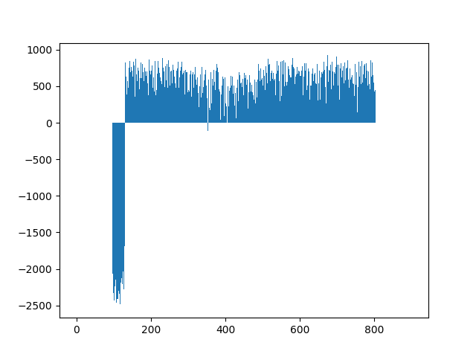
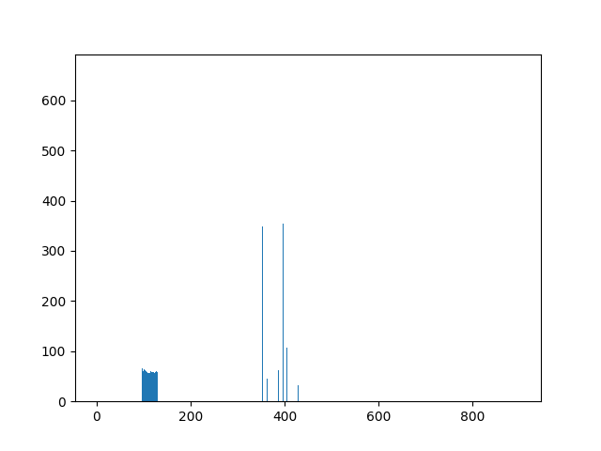
Case 3 Observations
Episode 0
Episode 950
Altitude Difference
Successful Steps

Slide 20
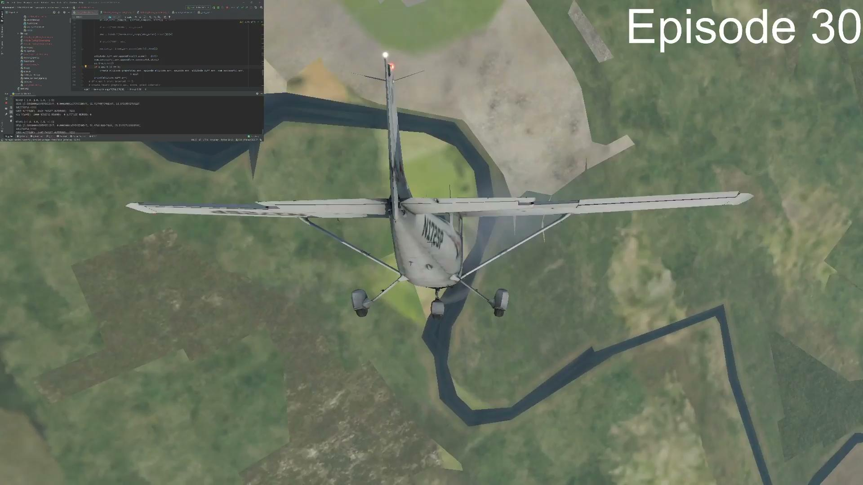

Slide 21
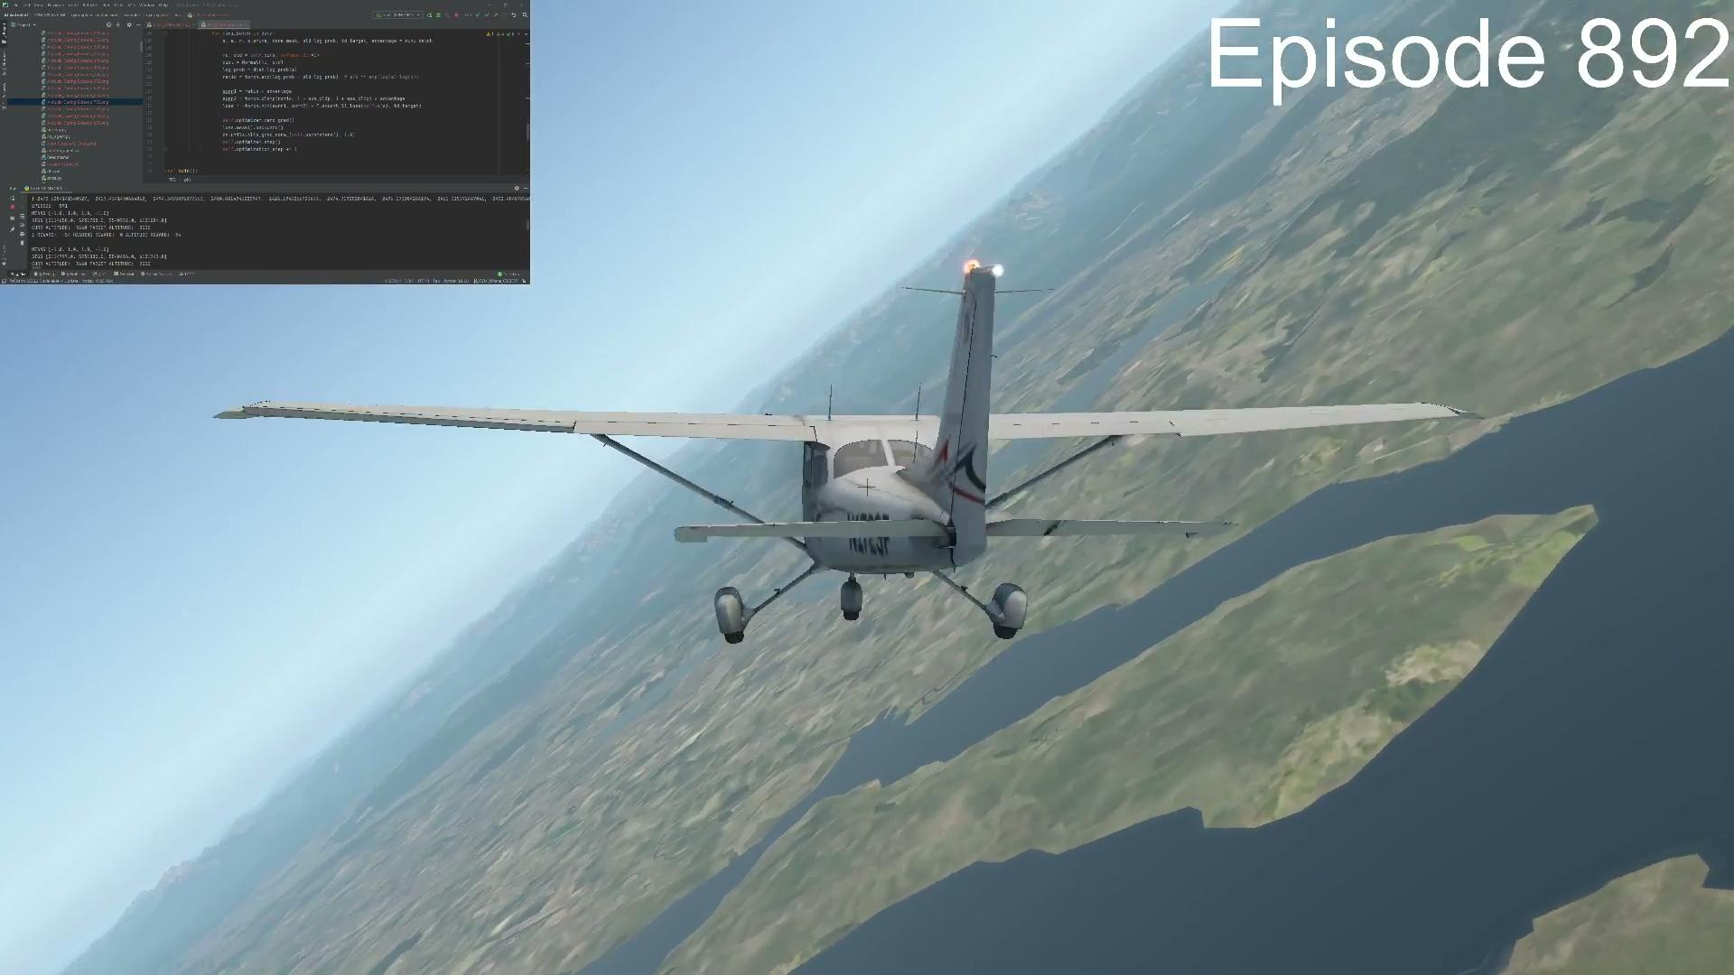

Slide 22
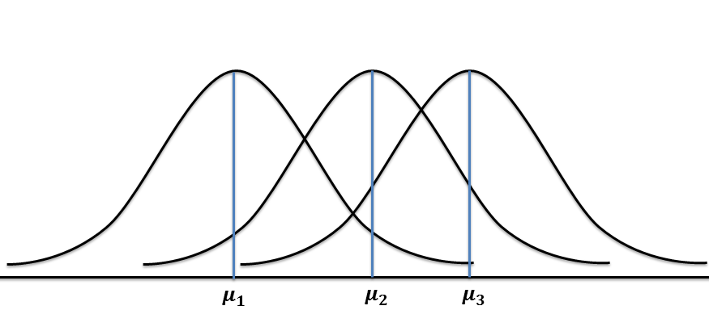
Case 4
NN Architecture:
Input_layer : 8 → ReLU
H1_layer : 256 → ReLU
H2_layer: 256 → ReLU
Output Layer: 4 (mu) No Activation Function
: 4 (sigma) → ELU + 0.001
𝜶 = 0.0001, 𝜸: 0.9
Reward: +6000 for every step in successful range
: -1 for each timestep
: -100000 for crashing
: -5000 for finishing outside the successful range
Results (500 Episodes): Satisfactory! After crashing in the first couple of episodes, the aircraft started “loitering” close to the target altitude.
-1
0
1

Slide 23
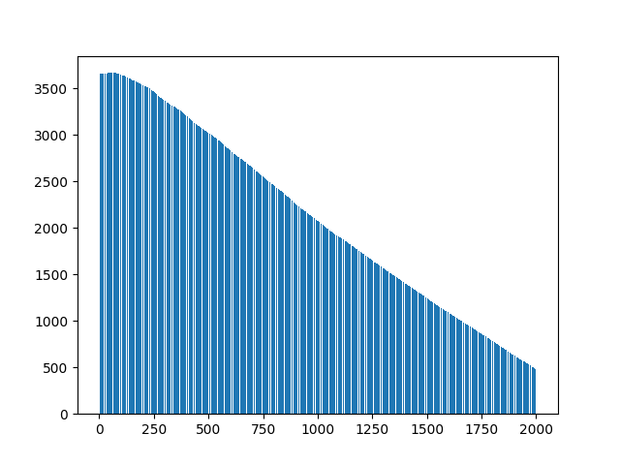
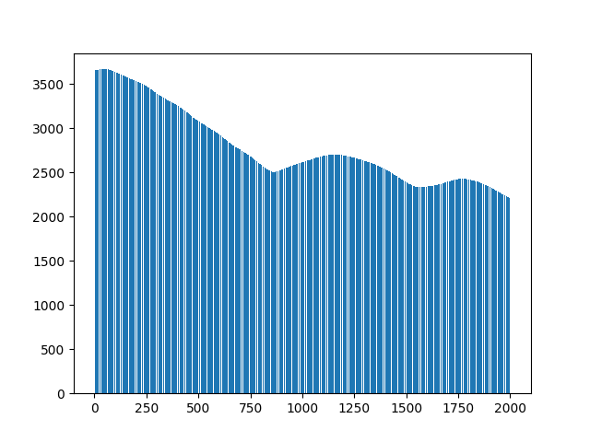
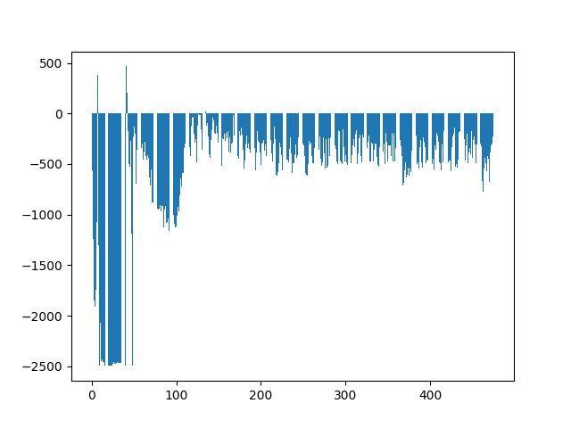
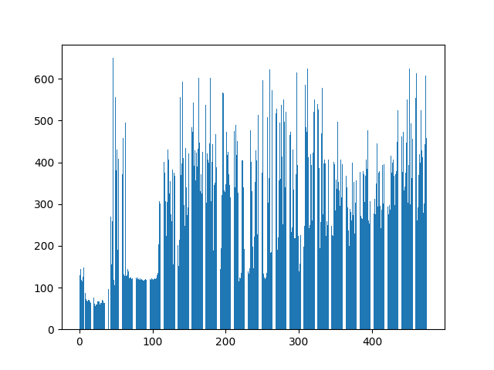
Case 4 Observations
Episode 1
Episode 475
Altitude Difference
Successful Steps

Slide 24
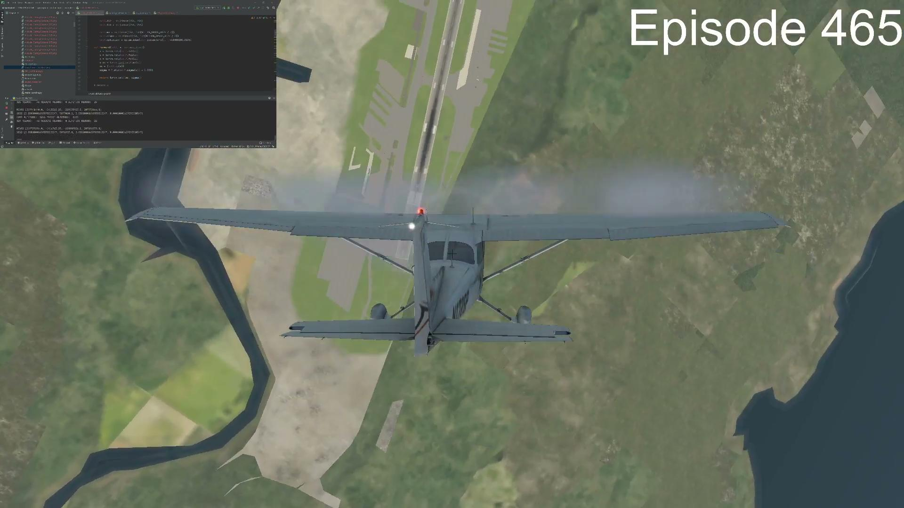

Slide 25
Next Steps
Fix upon a set of hyperparameters after experimenting a little and then train the model for longer (possibly on cloud) and then test it.
Compare performance gain and learning efficiency against other algorithms.
Try adding more datarefs to the observation space.

Slide 26
Project Goal
Proposal:
Implement RL Agent capable of following a given flight path
Compare the performance of different RL models
Deliverables for the finals:
Have (atleast) 3 RL models ready for navigating the aircraft through a predetermined flight path with clear visualization of suggested and actual flight paths.

Slide 27
Progress So Far...
Implementation of following algorithms in continuous action space:
REINFORCE
Deep Deterministic Policy Gradient
Proximal Policy Optimization

Slide 28
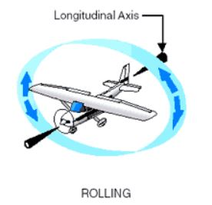
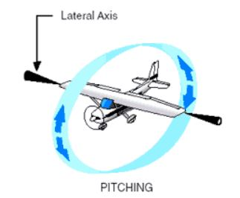
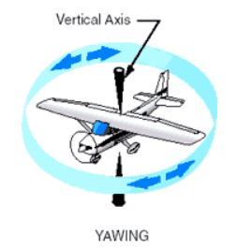
Current Problem Definition
The aircraft will be spawned at 3600m and the target is to descend to 2500m irrespective of the final attitude.
We chose the 8 most relevant observation space parameters and these include:
Indicated Airspeed
Vertical Velocity
Altitude
Pitch
Roll
True Heading
Angle of Attack
Sideslip Angle
The action space was limited to 4 actions which include:
Latitudinal Stick (to control the elevator / pitching motion)
Longitudinal Stick (to control the ailerons / rolling motion)
Rudder Pedals (to control rudder / yawing motion)
Throttle

Slide 29
Environment Setup
X-Plane 11’s API allows data access through UDP sockets.
NASA XplaneConnect plugin allows data to be read from/ written to the simulator without having to program sockets yourself.
It provides several functions to interact with the simulator like sendCTRL(), getCTRL(), getDREFs() etc.
There is 1 core functionality which is missing from the plugin is the ability to reload the configured flight (situation file).
To build this functionality we used another plugin called FlyWithLua and wrote the script in Lua to reload the situation file whenever the aircraft crashes or an episode finishes.
Send Action
Send UDP Packets
Python Script
X-Plane Connect
X-Plane 11
Get Observation
Rcv UDP Packets
Constantly Read Done Flag
Lua Script
Reload Situation File if Done

Slide 30
GYM XPlane
Open AI Gym does not have any environment for X-Plane 11.
We implemented our own functions following Gym guidelines.
These include step, compute_reward, check_terminal_state etc.
This essentially provides a level of abstraction between our agent and the simulator and make it simple to code the RL agents.

Slide 31
Reward Function
+6000 for every step in successful range
–√(|current_altitude – target_altitude|) for each step outside target zone
–100,000 for crashing
–20,000 for finishing outside the successful range

Slide 32
REINFORCE Algorithm
A policy gradient approach to solve problems dealing with continuous action spaces.
Network is modelled to output the parameters (mu, sigma)for 4 normal distributions corresponding to four actions in the action space.
Actions are sampled from these distributions and the corresponding rewards from the next states are then used to compute loss and perform backpropagation.

Slide 33
REINFORCE Algorithm
Performed training by varying hyperparameters and activation functions.
The best performance we got was using the following parameters:
NN Architecture:
Input_layer : 8 → No Activation Function
H1_layer : 256 → ReLU
H2_layer: 256 → ReLU
Output Layer: 4 (mu) No Activation Function
: 4 (sigma) → ELU + 0.001
𝜶 = 0.001, 𝜸: 0.9
Results (500 Episodes): Promising! After crashing in the first couple of episodes, the aircraft started “loitering” close to the target altitude.

Slide 34
REINFORCE Results
Episode 1
Episode 475
Altitude Difference
Successful Steps

Slide 35
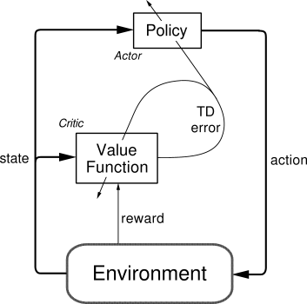
Proximal Policy Optimization (PPO)
Actor-Critic method based algorithm to solve problems dealing with continuous action spaces.
2 networks are trained in parallel.
Actor network outputs the normal distribution parameters for sampling actions. Critic network approximates the value function for the current state.
Rewards and value function are used to compute the advantage used in calculations for loss and backpropagation

Slide 36
Proximal Policy Optimization (PPO)
We used the same network from REINFORCE as our actor network and for value network as well, except that at the output layer it has just 1 output for value function.
During the first training session of 500 episodes, the results were not satisfactory.
The average scores plateaued.
The reason which we realised was that the buffer size that we were using was very small.

Slide 37
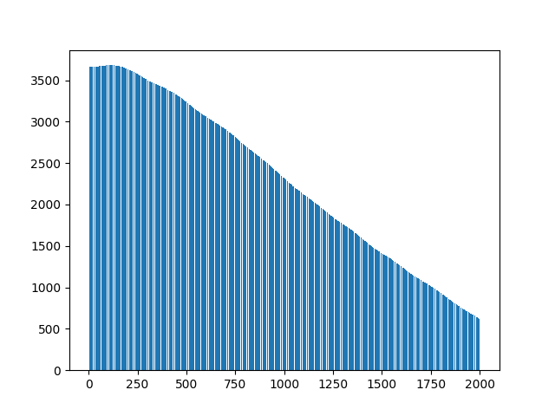
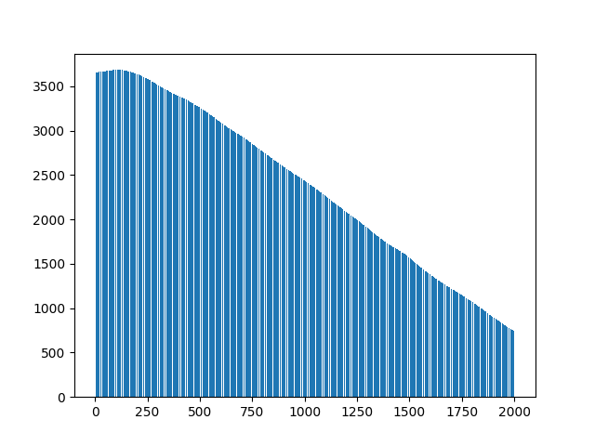
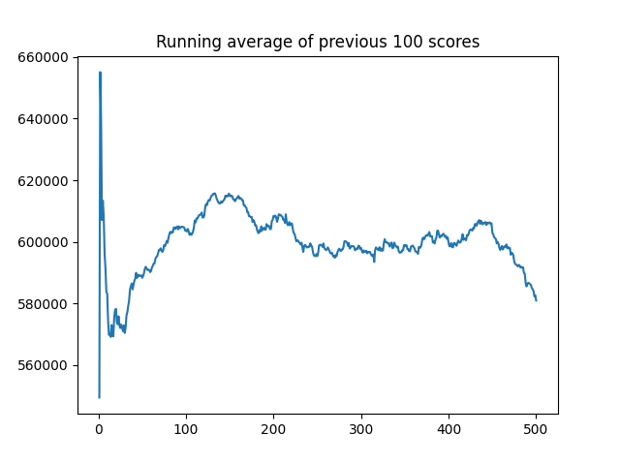
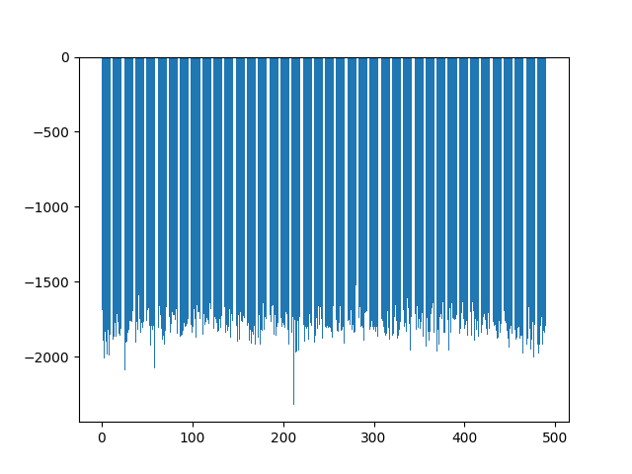
PPO Results
Episode 10
Episode 490
Successful Steps

Slide 38
Deep Deterministic Policy Gradient
Network Structure:
Batch Size: 64
Target Update Factor: 0.001
2 layers Actor:
learning rate: 0.0001
2 layers Critic:
learning rate: 0.001
Memory buffer size: 1000,000

Slide 39
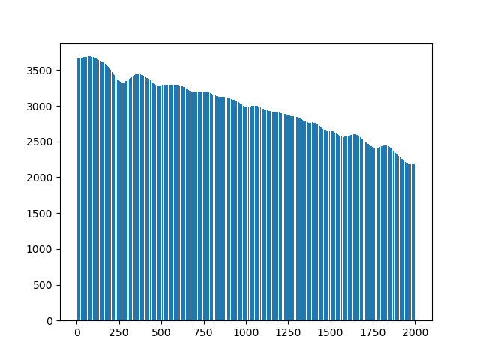
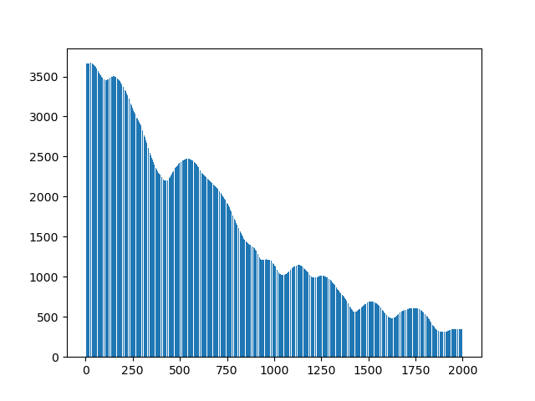
Deep Deterministic Policy Gradient
Altitude after 200 episodes: Some interesting episodes:

Slide 40
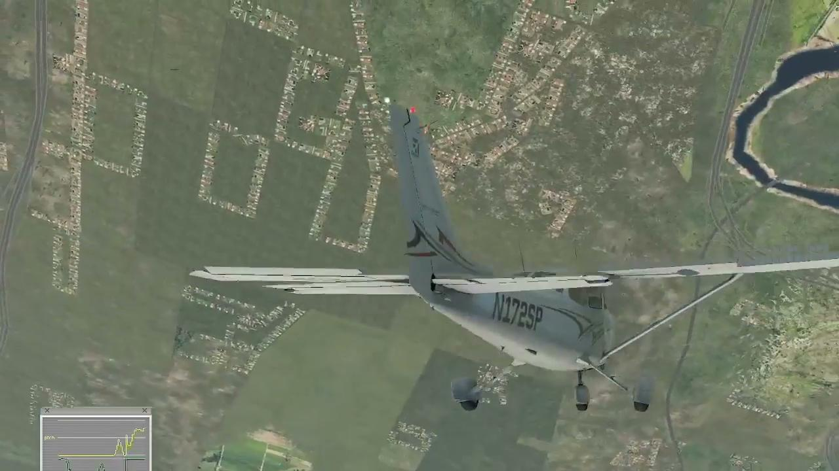

Slide 43
Future Tasks
Agents:
Train PPO with large enough replay buffer for enough epochs so that the model can capture the patterns.
Try out more complicated networks so that the model can pick on the complex underlying patterns.
Make necessary changes to DDPG
Environment and Objective:
Switch from a fixed target altitude approach to any given target altitude. This will enable the model to learn the generic flight level change behaviour instead of just descending to 2500m.
Reducing the number of steps in each episodes and keeping the target altitude closer to the spawn altitude. This would help us run more episodes in the same time.

Slide 44
Individual Contributions
Muhammad Rizwan Malik:
Environment/Gym Setup, REINFORCE Debugging, PPO Implementation, Mid Term Presentation
Muhammad Oneeb Ul Haq Khan:
REINFORCE Implementation/Debugging, EDD, Technical Paper, Mid Term Presentation
Martin Huang:
DDPG Implementation, EDD, Mid Term Presentation
Krishnateja Gunda:
REINFORCE Implementation, EDD, Technical Paper
Rengapriya Aravindan:
DDPG, EDD, Technical Paper, Project Website methods

Slide 45
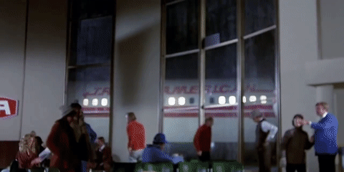
THANK YOU!

Slide 46
Presentation Feedback
Revise timeline slide
Change cover photo
Decide on standard metrics to be used every week
Add explanation of each agent and network architecture + reason why?

Slide 47
Pending Tasks
Change observation space to include relative altitude and heading instead of absolute
Make someone responsible for visualization of presentation, paper, videos
Use same graphing module for every agent
Add Flight path goal should be to run an entire 3D flight path
Hyper parameter tuning
Headless version running

Slide 48
Cases To Run
Case 1: Input Normalization, Remove Negative Sign for Loss - Oneeb
Case 2: Input Normalization, Negative Sign for Loss - Rizwan
Case 3: w/o Input Normalization, w/ Sign for Loss that Works - Rizwan

